Slide 1
Incremental Development
+ Prototype
+ Guerilla Usability Testing
Prototype
Global Requirements
Global Design
Increment Requirements
Increment Design
Delivered System
Increment Testing
Increment Implementation
Guerilla Usability Testing

Slide 2
Extreme Programming – Refactoring Code
Other – Coding Conventions
Other – Continuous Integration (Get definition right)

Slide 3
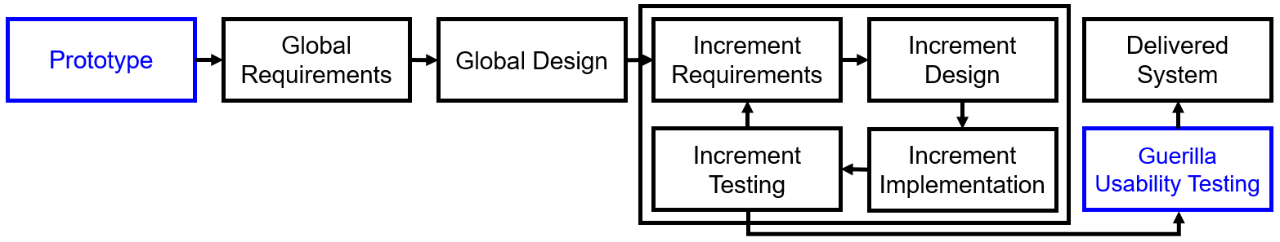

Slide 4
Increment 1 – Accounts
Increment 2 – Create Emails
Increment 3 – Email Inboxes
Prototype
Global Requirements
Global Design
Increment Requirements
Increment Design
Delivered System
Increment Testing
Increment Implementation
Guerilla Usability Testing

Slide 5
